Slide 1
Beyond PR - Post-Polio Syndrome
22nd - 23rd September 2015

Slide 2
Prompted awareness
WBP_q1. Before taking this survey, which, if any, of the following neurological disorders/ illnesses had you ever heard of? (Please select all that apply)
Alzheimer’s disease
Parkinson’s disease
Epilepsy
Motor neurone disease
Late Effects of Polio
Post-Polio Syndrome (PPS)
None of these
Base: All GB adults (2034)

Slide 3
Level of surprise after reading about PPS
WBP_q2. Post-Polio Syndrome (PPS) is a neurological condition that can occur in people who have had Polio. After a period of time without experiencing any symptoms, people may develop new symptoms of increasing weakness, stamina problems, fatigue (i.e. tiredness) and muscle pain.According to the NHS, around 120,000 people in the UK who have had Polio are now suffering from Post-Polio Syndrome, which is around the same number as those suffering from Parkinson’s or Motor neurone disease.After reading this, how surprised, if at all, would you say you are about the number of people suffering from Post-Polio Syndrome?
Very surprised
Fairly surprised
Not very surprised
Not at all surprised
Don't know
Base: All GB adults (2034)

Slide 4
Wheelchair users and those with accessibility requirements
WBP_q3. Thinking in general about people who need to use wheelchairs or have other mobility or accessibility requirements...Which ONE, if any, of the following statements do you most agree with?
In general, I think wheelchair users and those with accessibility requirements are already well catered for and no more needs to be done
In general, I think more needs to be done to help improve accessibility for wheelchair users and those with other accessibility requirements
I don’t understand the requirements and provisions provided for accessibility for wheelchair users or those with other accessibility requirements very well, but would like to know more
None of these
Base: All GB adults (2034)

Slide 5
Level of concern after reading about research
WBP_q4. "Research by Revitalise in 2014 showed that many of the UK’s busiest and/ or most popular tourist attractions did not comply with basic guidelines on accessibility for wheelchair users (e.g. trained staff, lifts/ hoists etc.)."After reading this, how concerned, if at all, are you about the general accessibility for wheelchair users at any/ all tourist attractions?
Very concerned
Fairly concerned
Not very concerned
Not at all concerned
Don't know
Base: All GB adults (2034)

Slide 6
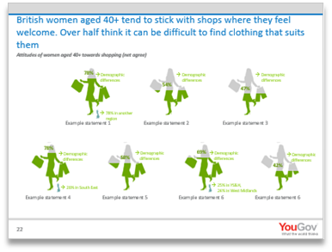
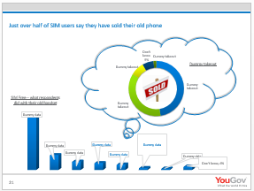
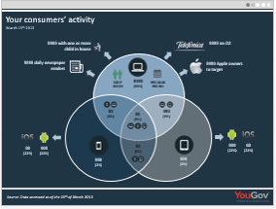
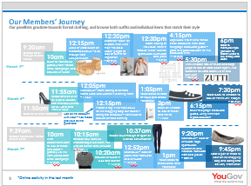
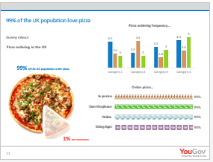
Custom research at YouGov
The charts in this presentation show your "topline" findings but did you know that we are able to do so much more for you?!
YouGov has expert specialised research teams who know your industry and audiences inside-out.
Our sector specialists (Consumer, Digital, Media and Technology, Financial Services, Public Services) combine research expertise with in-depth knowledge to help you identify and analyse your markets, as well as offer actionable insight on how to best achieve your business/ organisation objectives
For more information, contact the Custom Research team on customresearch@yougov.com or call +44 20 7012 6000

